Slide 1




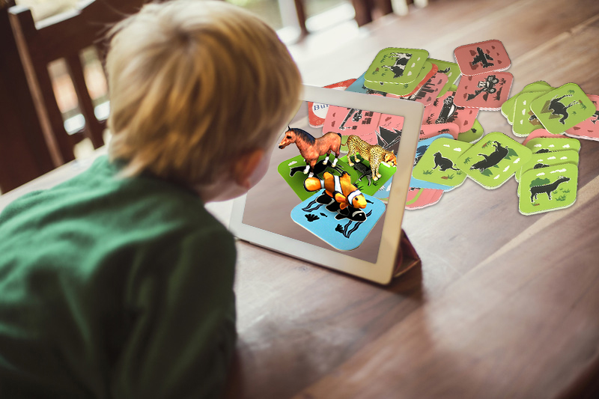



DIGITAL. INNOVATION. SCALE

Slide 2

Agenda
Adapter Design Pattern
What is Adapter
When to use
Examples
+/-
What we need
Questions and answers

Slide 3
What is Adapter Design Pattern
Structural Design Pattern
Convert the interface of a class into another interface clients expect.
Adapter lets classes work together that couldn't otherwise because of incompatible interfaces.
How can a class be reused that has not the interface clients require?
How can classes work together that have incompatible interfaces?
Convert the interface of a class into another interface clients expect.
Define a separate Adapter class that converts the interface of a class (Adaptee) into another interface (Target) clients require.
Clients that require a Target interface can work through an Adapter to work with classes that have an incompatible (not the Target) interface.

Slide 4
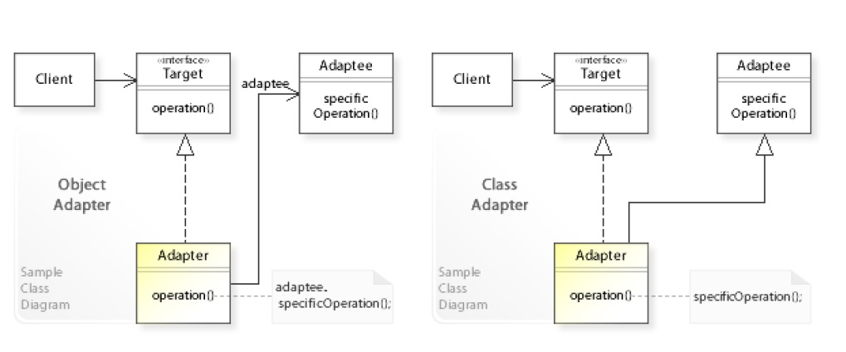
Example

Slide 5
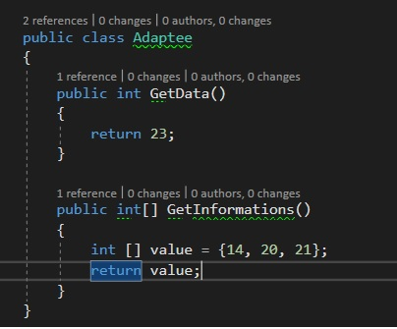
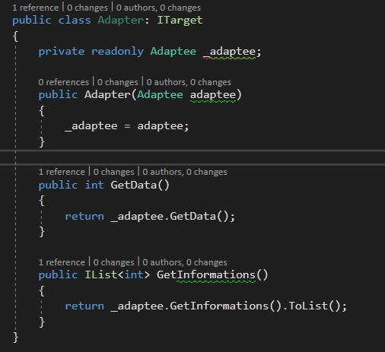
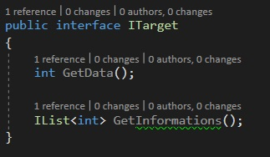
Example

Slide 6
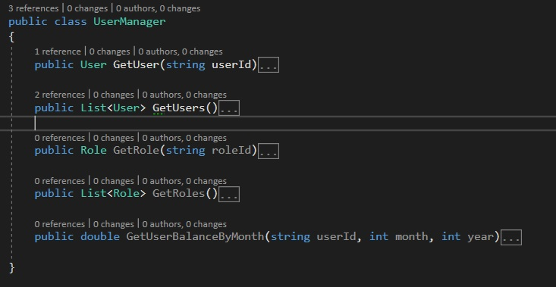
Example

Slide 7
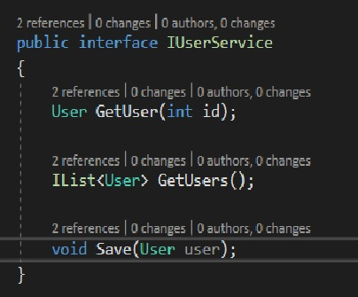
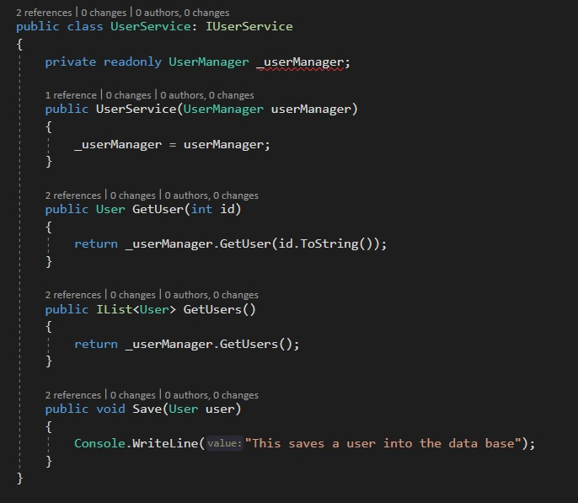
Example

Slide 8
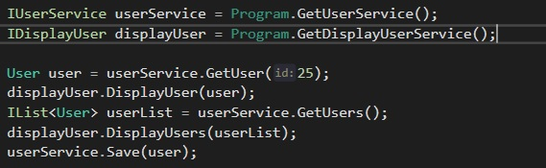
Example

Slide 9
Advantages
Advantages
Supports reusing existing functionality.
Often an already existing reusable object can not be reused only because its interface does not match the interface a client depends on.
By working through an adapter, clients can reuse existing objects that provide the needed functionality but not the needed interface.
Object adapter is more flexible than class adapter.
The class adapter implements a Target interface in terms of (by inheriting from) an Adaptee class.
This commits the class adapter to an Adaptee class at compile-time and wouldn't work for other Adaptee classes.
Furthermore, if the Adaptee implementation classes belong to an other application, they are usually hidden and can't be accessed.
The object adapter, on the other hand, implements a Target interface in terms of (by delegating to) an Adaptee object at run-time (independently from Adaptee implementation classes).

Slide 10
Disadvantages
Disadvantages
Have a direct dependency from legacy code
Is rigid, because we inject a specific object

Slide 11
What we need
Participants
Adaptee – the class that we want to reuse
Target – The target interface
Adapter – Implements the target and uses the adaptee
Client

Slide 12
Questions

Slide 13
References
GOF – Design Patterns - http://www.w3sdesign.com/GoF_Design_Patterns_Reference0100.pdf
Dotfactory - https://www.dofactory.com/net/design-patterns
Code example - https://gitlab.softvision.ro/enterprise.net/design-patterns/adapter
https://github.com/svdcretu/designPatterns/tree/master/Structural

